Slide 1
HNDIT2302 IT Project Management
Project Human Resource Management

Slide 2
Learning Objectives
Define project human resource management and describe its processes.
Summarize key concepts for managing people
Identify the tools for HR management (project organizational chart, responsibility assignment matrix, and resource histogram)
Explain the concepts of resource assignments, resource loading, and resource leveling

Slide 3
What is Project Human Resource Management?
Project human resource management includes the processes required to make the most effective use of the people involved with a project. Processes include
Organizational planning
Staff acquisition
Team development

Slide 4
Keys to Managing People
Psychologists and management theorists have devoted much research and thought to the field of managing people at work
Important areas related to project management include
motivation (intrinsic and extrinsic)
influence and power
effectiveness

Slide 5
Motivation
Abraham Maslow developed a hierarchy of needs to illustrate his theory that people’s behaviors are guided by a sequence of needs
Maslow argued that humans possess unique qualities that enable them to make independent choices, thus giving them control of their destiny

Slide 6
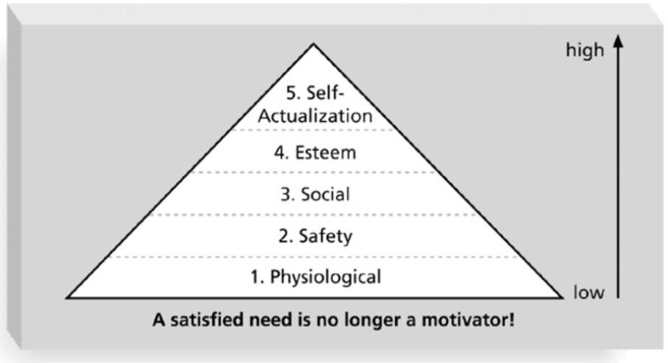
Maslow’s Hierarchy of Needs

Slide 7
Ways to Influence that Help and Hurt Projects
Projects are more likely to succeed when project managers influence with
expertise
work challenge
Projects are more likely to fail when project managers rely too heavily on
authority
money
penalty

Slide 8
Power
Power is the potential ability to influence behavior to get people to do things they would not otherwise do
Types of power include
Coercive
Legitimate
Expert
Reward
Referent

Slide 9
Improving Effectiveness - Covey’s 7 Habits
Project managers can apply Covey’s 7 habits to improve effectiveness on projects
Be proactive
Begin with the end in mind
Put first things first
Think win/win
Seek first to understand, then to be understood
Synergize
Sharpen the saw

Slide 10
Empathic Listening and Rapport
Good project managers are empathic listeners; they listen with the intent to understand
Before you can communicate with others, you have to have rapport
Mirroring is a technique to help establish rapport
IT professionals often need to develop empathic listening and other people skills to improve relationships with users and other stakeholders

Slide 11
Improving Relationships Between Users and Developers
Some organizations require business people, not IT people, to take the lead in determining and justifying investments in new computer systems
CIOs push their staff to recognize that the needs of the business must drive all technology decisions
Some companies reshape their IT units to look and perform like consulting firms

Slide 12
Organizational Planning
Organizational planning involves identifying, documenting, and assigning project roles, responsibilities, and reporting relationships
Outputs and processes include
project organizational charts
work definition and assignment process
responsibility assignment matrixes
resource histograms

Slide 13
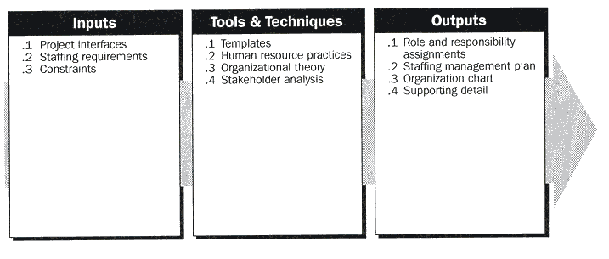
Organizational Planning

Slide 14
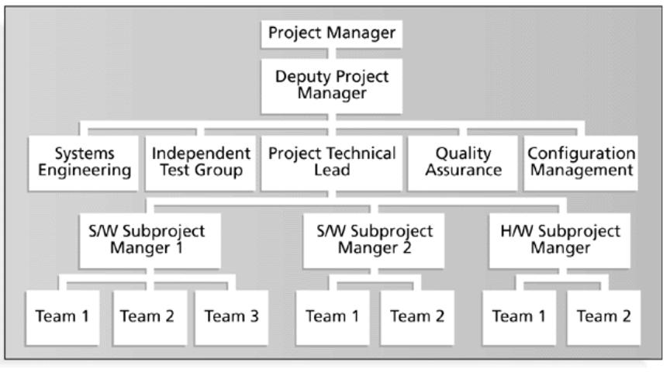
Sample Organizational Chart for a Large IT Project

Slide 15
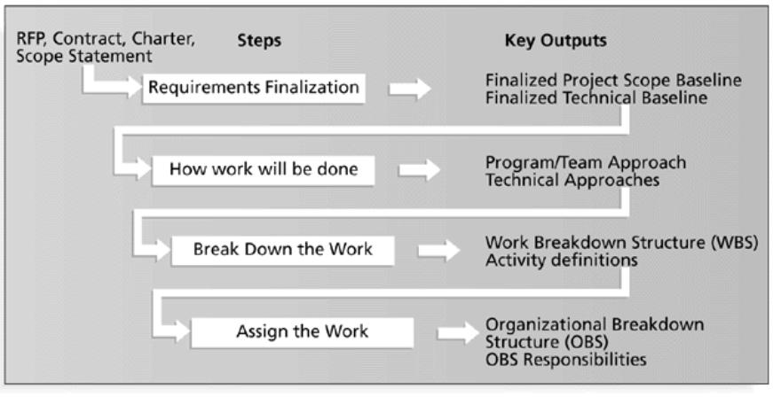
Work Definition and Assignment Process

Slide 16
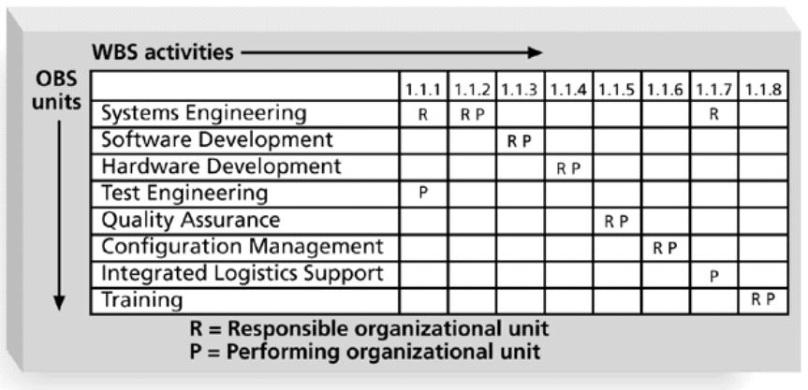
Sample Responsibility Assignment Matrix (RAM)

Slide 17
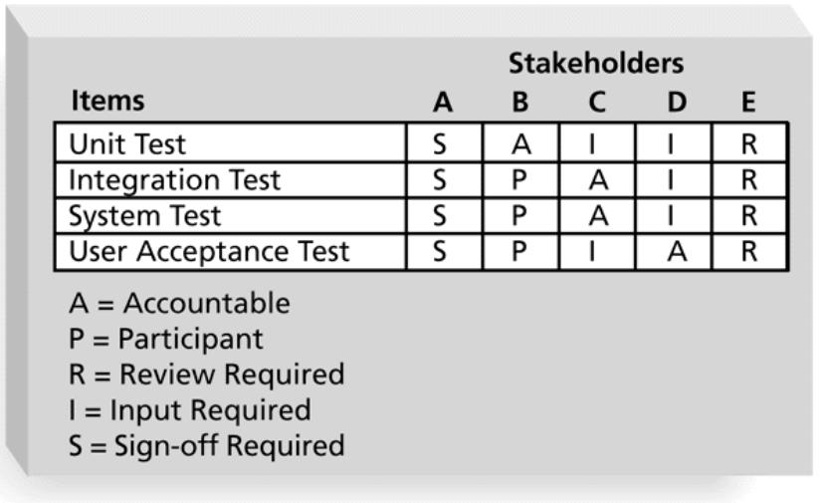
RAM Showing Stakeholder Roles

Slide 18
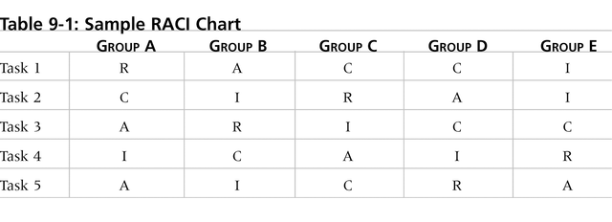
Sample RACI Chart
R = responsibility, only one R per task
A = accountability
C = consultation
I = informed

Slide 19
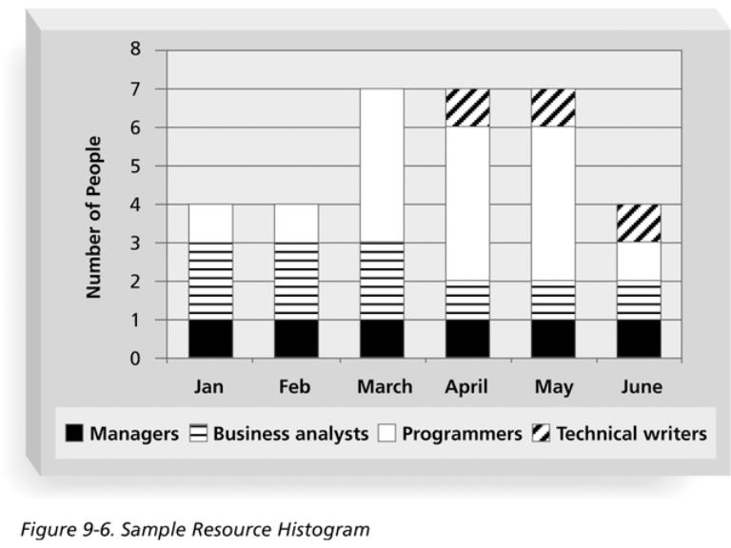
Sample Resource Histogram

Slide 20
Staff Acquisition
Staffing plans and good hiring procedures are important in staff acquisition, as are incentives for recruiting and retention
Some companies give their employees one dollar for every hour a new person they helped hire works
Some organizations allow people to work from home as an incentive
Research shows that people leave their jobs because they don’t make a difference, don’t get proper recognition, aren’t learning anything new, don’t like their coworkers, and want to earn more money

Slide 21
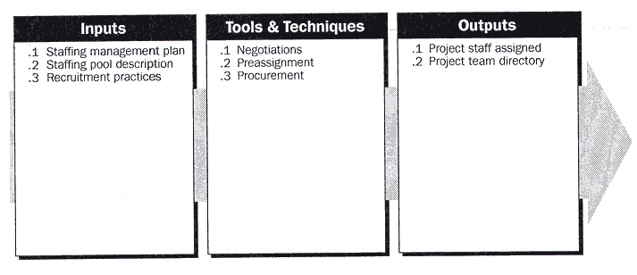
Staff Acquisition

Slide 22
Resource Loading and Leveling
Resource loading refers to the amount of individual resources an existing project schedule requires during specific time periods
Resource histograms show resource loading
Overallocation means more resources than are available are assigned to perform work at a given time

Slide 23
Resource Leveling
Resource leveling is a technique for resolving resource conflicts by delaying tasks
The main purpose of resource leveling is to create a smoother distribution of resource usage and reduce over allocation

Slide 24
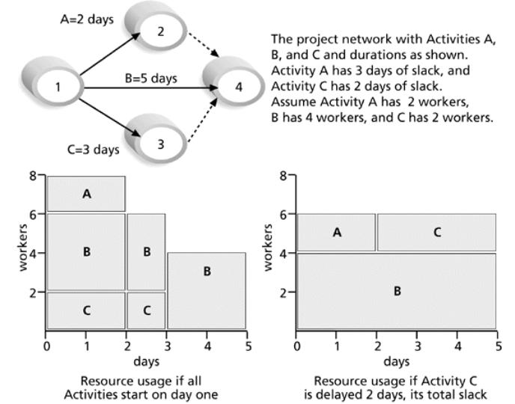
Resource Leveling Example

Slide 25
Team Development
It takes teamwork to successfully complete most projects
Training can help people understand themselves, each other, and how to work better in teams
Team building activities include
physical challenges
psychological preference indicator tools

Slide 26
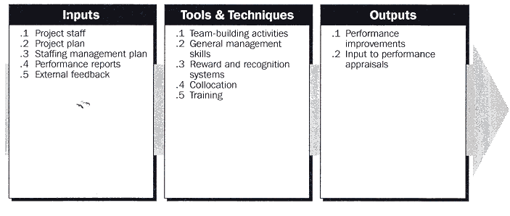
Team Development

Slide 27
Social Styles Profile
People are perceived as behaving primarily in one of four zones, based on their assertiveness and responsiveness:
Drivers
Expressives
Analyticals
Amiables
People on opposite corners (drivers and amiables, analyticals and expressives) may have difficulties getting along

Slide 28
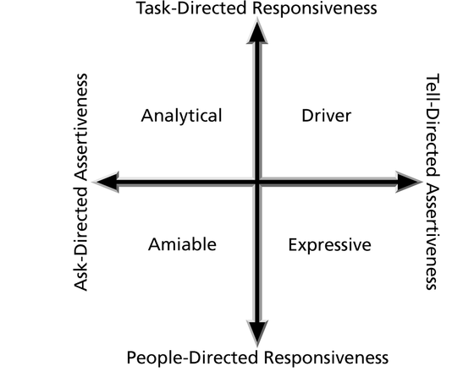
Social Styles

Slide 29
Reward and Recognition Systems
Team-based reward and recognition systems can promote teamwork
Focus on rewarding teams for achieving specific goals
Allow time for team members to mentor and help each other to meet project goals and develop human resources

Slide 30
General Advice on Teams
Focus on meeting project objectives and producing positive results
Fix the problem instead of blaming people
Establish regular, effective meetings
Nurture team members and encourage them to help each other
Acknowledge individual and group accomplishments

Slide 31
Using Software to Assist in Human Resource Management
Software can help in producing RAMs and resource histograms
Project management software includes several features related to human resource management such as
viewing resource usage information
identifying under and overallocated resources
leveling resources

Slide 32
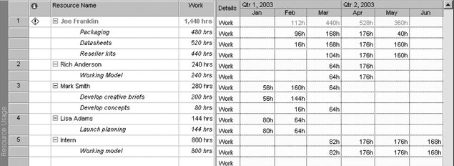
Resource Usage View from Microsoft Project

Slide 33
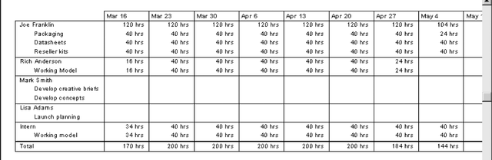
Resource Usage Report from Microsoft Project

Slide 34
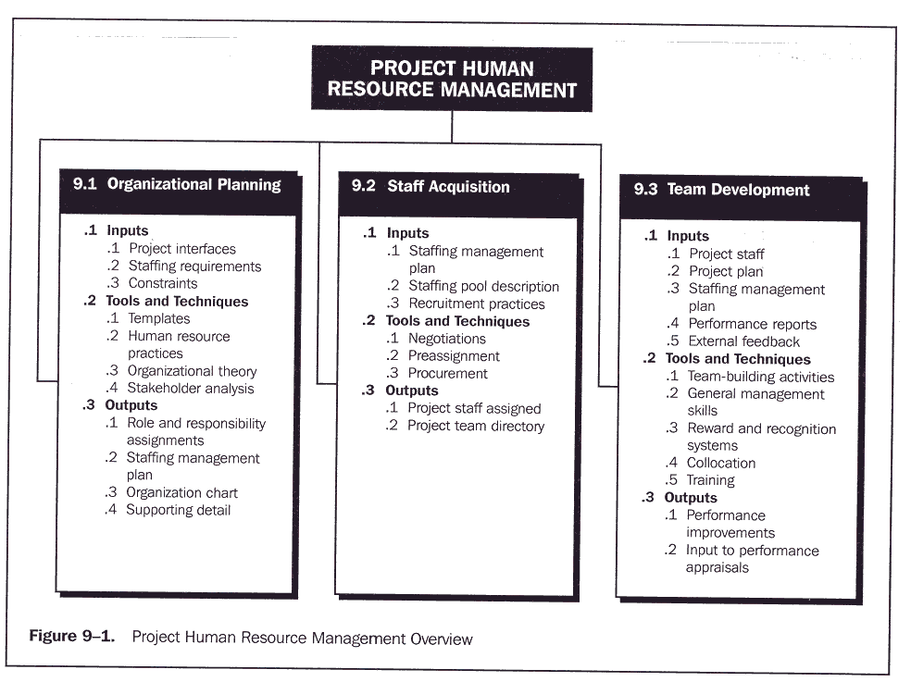
Project Human Resource Management

Slide 35
References
“Information Technology Project Management”, Kathy Schwalbe, sixth Edition, THOMSON Course Technology

